Slide 1
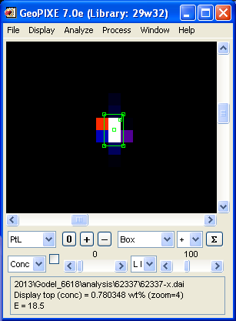

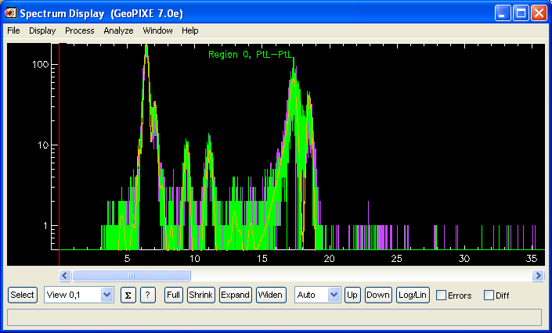
Remember to Save region(s) to file
“Outer” and “Inner” spectra after fit

